Slide 1
DESIGN
THEORY
by SUBHRAJIT DUTTA ( AEC CODING CLUB )

Slide 2
WHAT
is
DESIGN?

Slide 3
The
‘organisation’
and
‘presentation’
of
‘information’ developed
through a
‘creative process’
for a
‘particular function’.
THINKING
PROBLEM SOLVING
PRACTICALITY

Slide 4
WHY
design ?

Slide 5
To decide
upon the look
and function of something
before
it’s made

Slide 6
DESIGN
THEORY

Slide 7
VISUAL
ELEMENTS
DESIGN PRINCIPLES

Slide 8
ELEMENTS
OF
DESIGN

Slide 9
The elements of design are the visual components that
make up a design.

Slide 10
KEY
ELEMENTS
OF
DESIGN
LINE
COLOUR
SHAPE
TEXTURE
FORM
TYPOGRAPHY

Slide 11
LINES
Used considerately
LINES can add elegance to a composition, add hierarchy and to draw the eye to a specific point

Slide 12
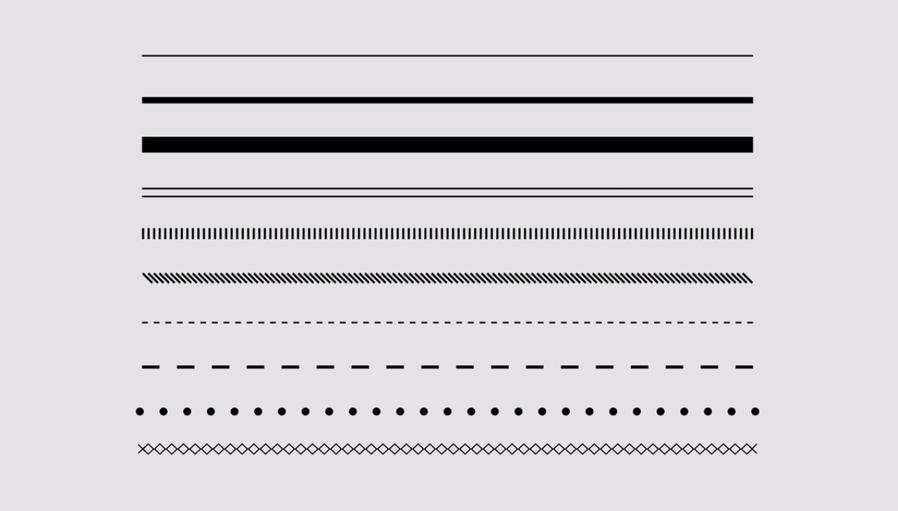
Some examples of popularly used lines

Slide 13
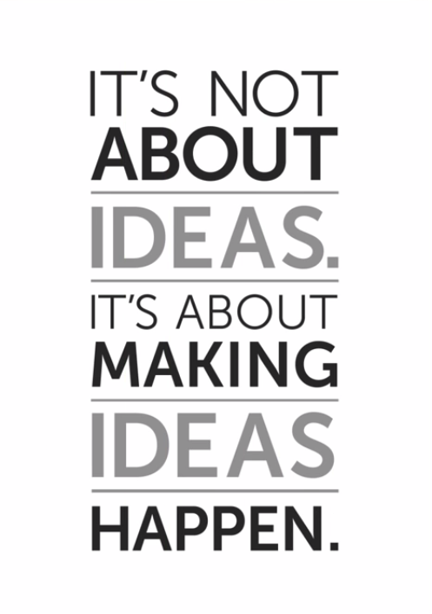
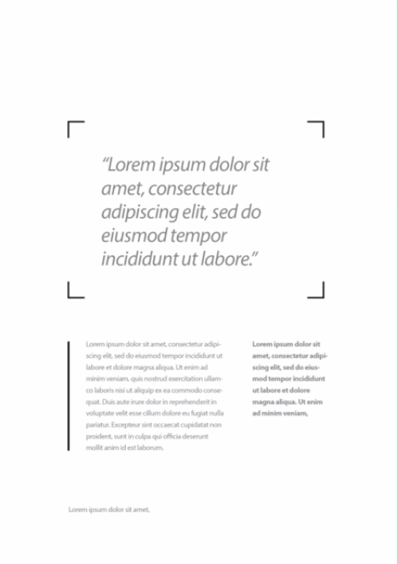
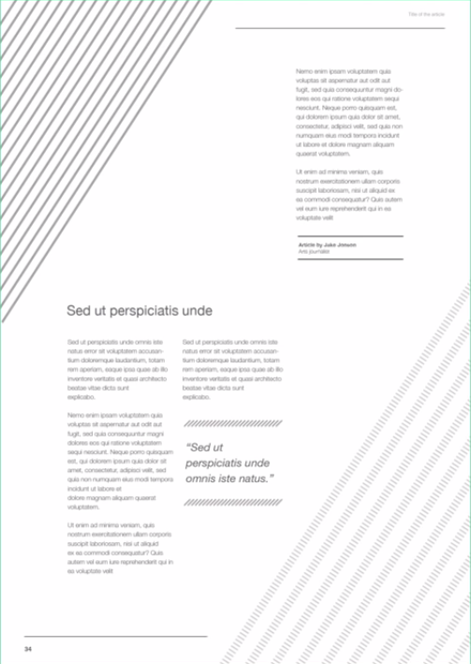
Some examples of wise use of lines to enrich the basic layouts

Slide 14
COLOUR
Referred as a magnet in the world of design, if used wisely.
It can create emphasis, mechanism of organisation and make immense impact.

Slide 15
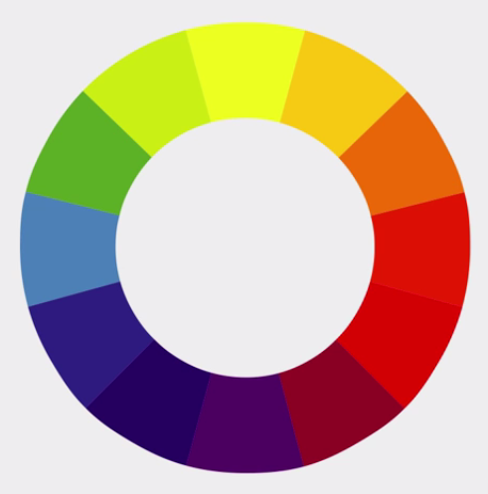
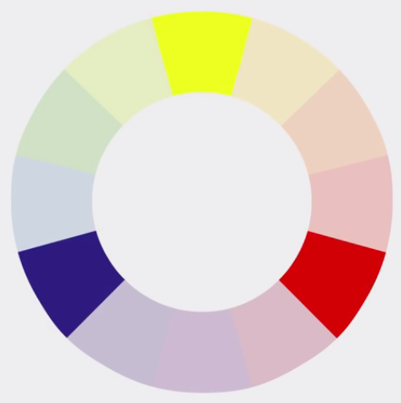
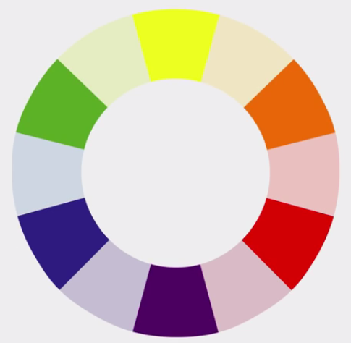
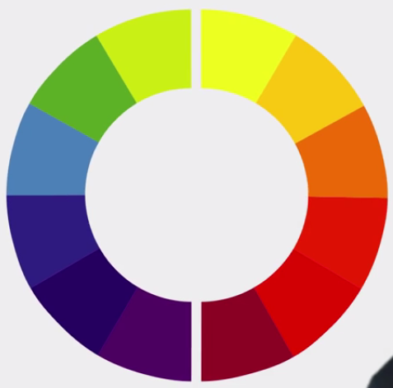
Colour wheel and it’s segments
COLOUR WHEEL
PRIMARY COLOURS
WARM
SECONDARY COLOURS
COOL

Slide 16
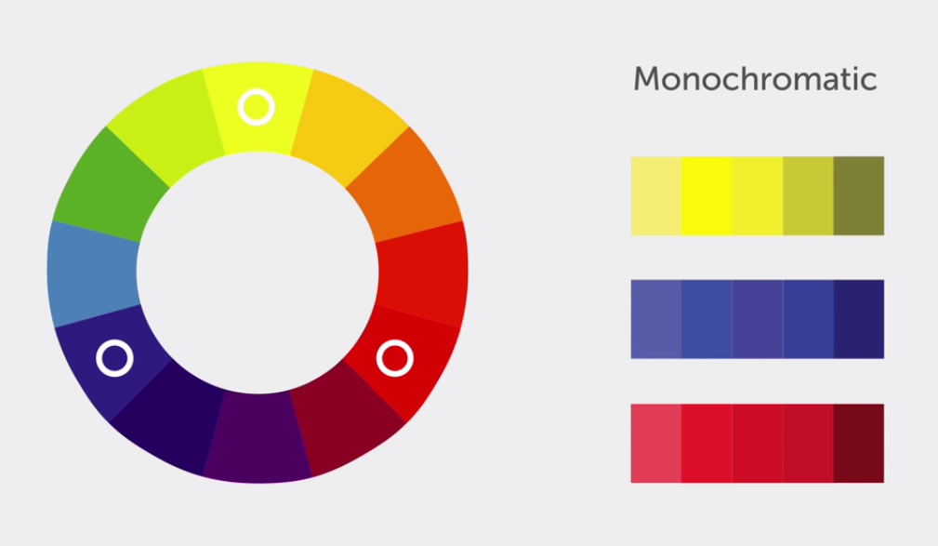
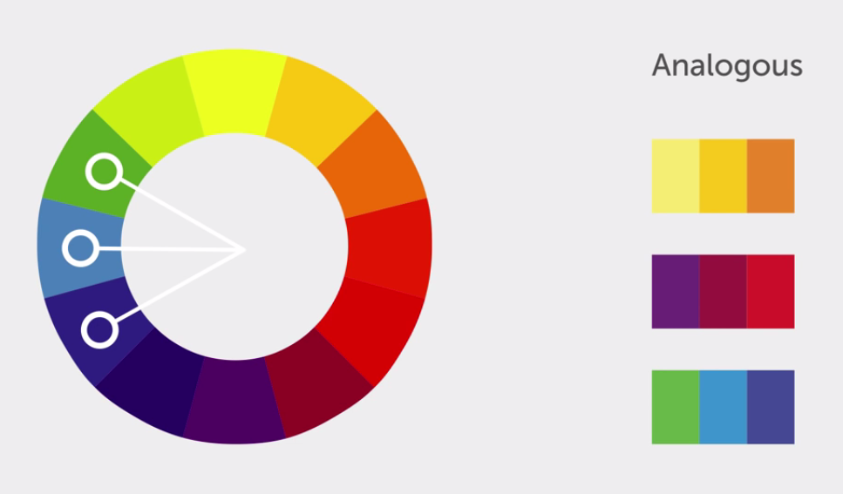
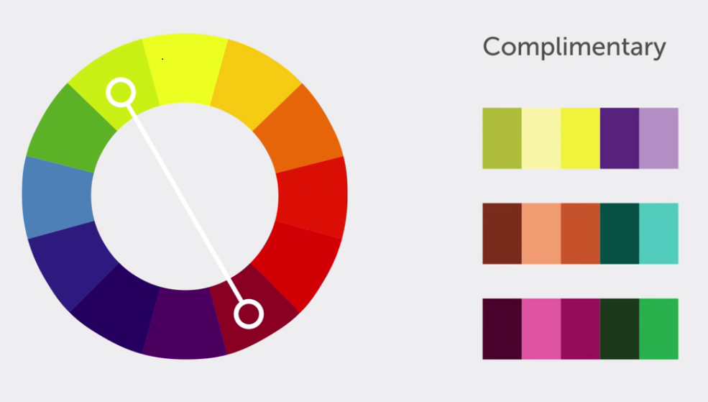
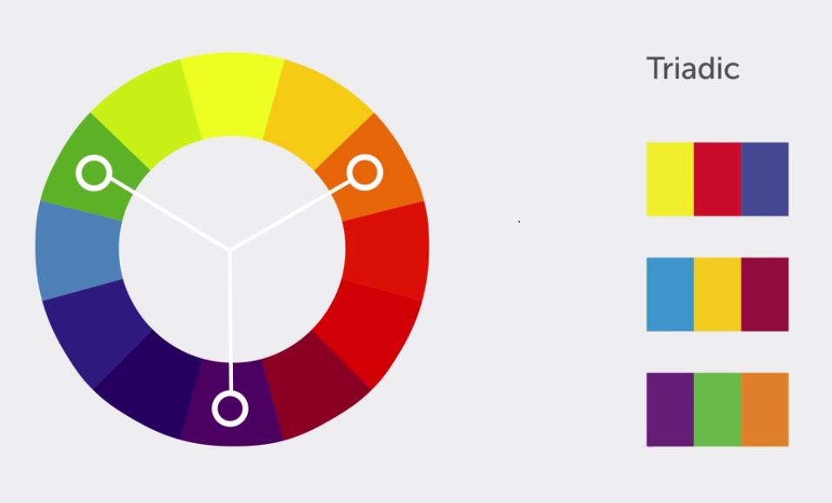
COLOUR RULES

Slide 17
SHAPE
However simple or complex it’s the relationship between shapes that can trigger feelings, convey a message, engage an audience, add emphasis to a layout and create movement

Slide 18
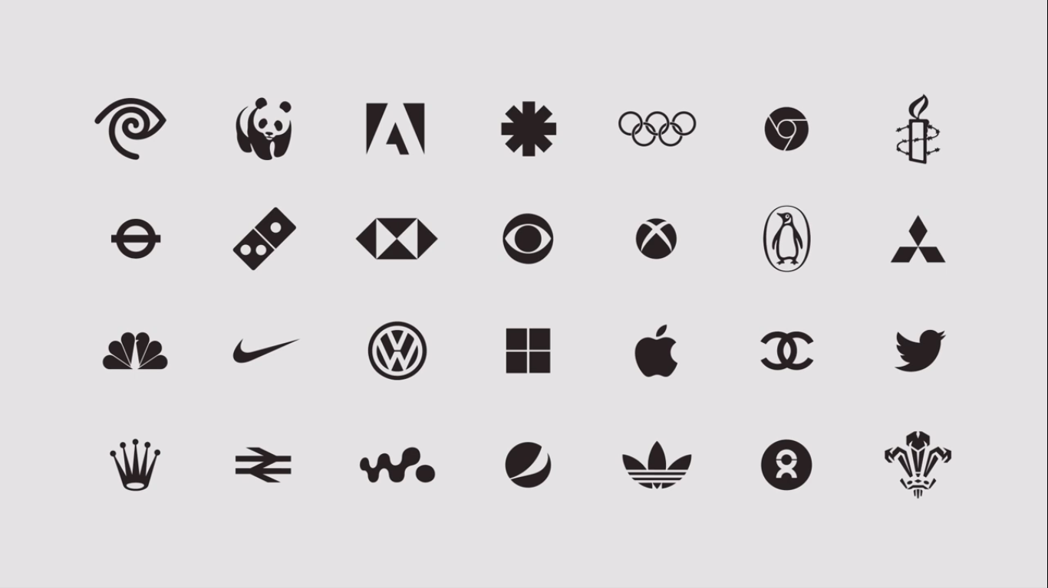
Examples of most popular logos or symbols made using shapes

Slide 19
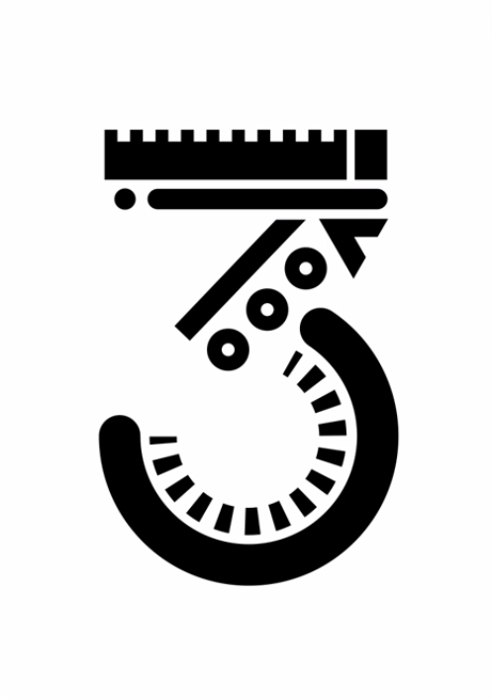
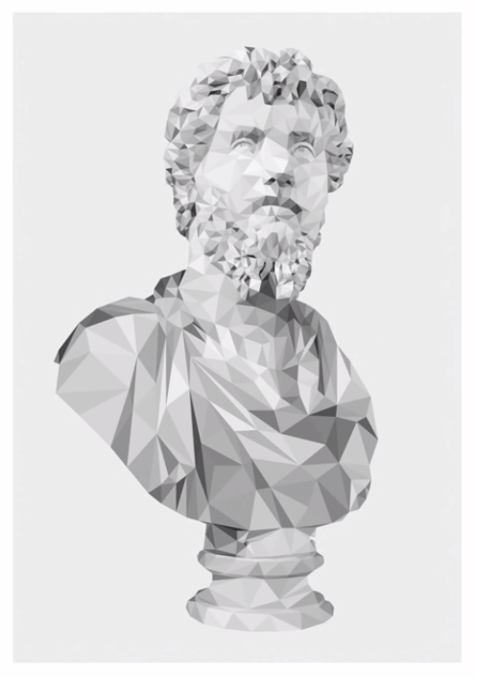

Examples showing some wise illustration of shapes

Slide 20
TEXTURE
It is used to create a visual tone and can influence the feel of a design work

Slide 21



IMAGE TEXTURES
ENVIRONMENTAL
BIOLOGICAL
MAN-MADE

Slide 22


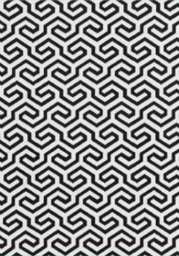
PATTERN TEXTURES

Slide 23
FORM
Because of visual dynamics, forms can be used to create a distinct look and feel to a piece of Design

Slide 24

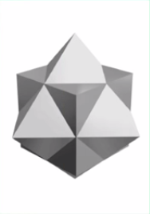

GEOMETRIC FORMS

Slide 25

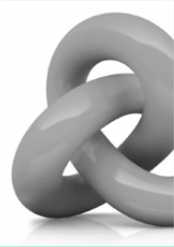

ORGANIC FORMS

Slide 26
TYPOGRAPHY
The choice of typeface used in a design is crucial to set the intended look and feel, set a tone and add character to a piece of work

Slide 27
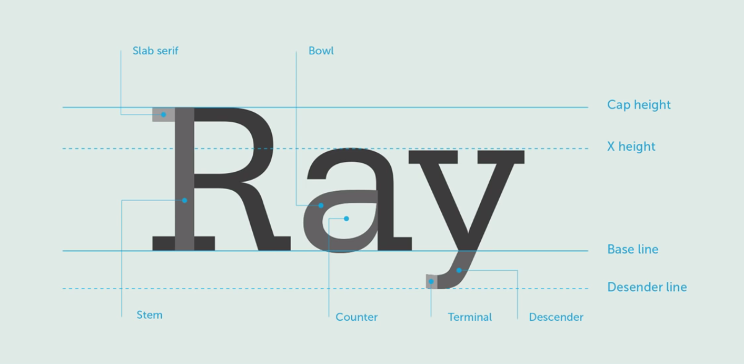
ANATOMY OF TYPOGRAPHY

Slide 28
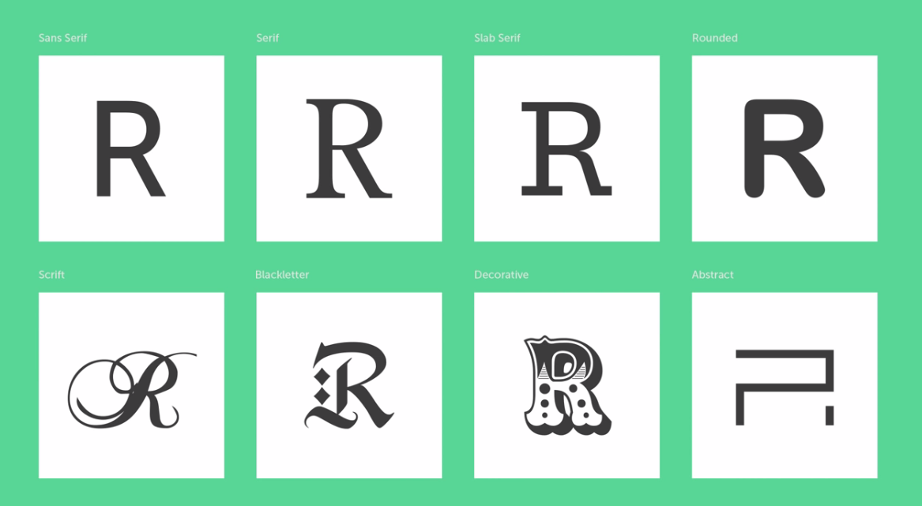
MAINSRTEAM TYPEFORMS

Slide 29
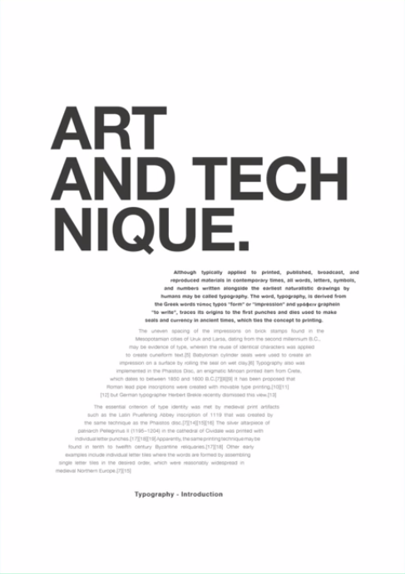
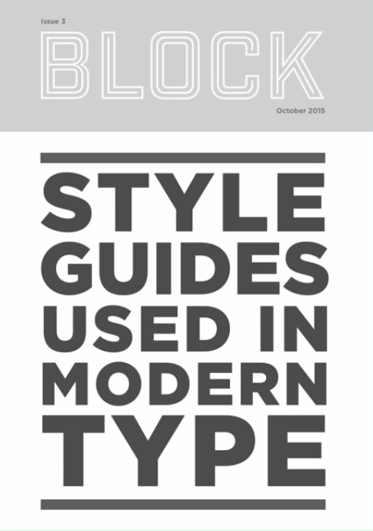
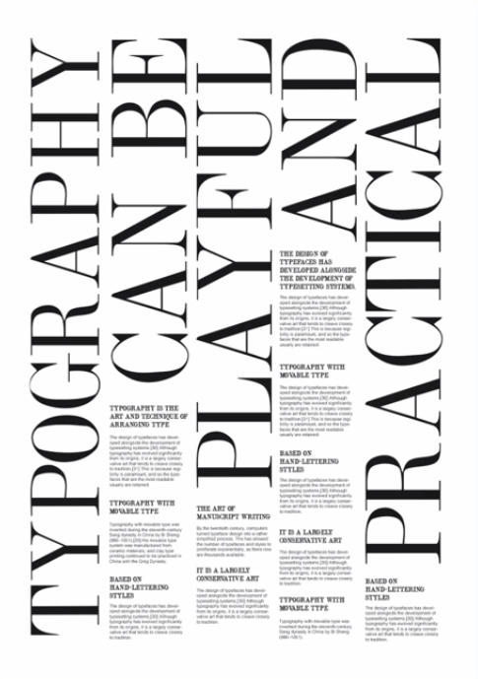
EXAMPLES OF SOME GOOD APPLICATION OF TYPE

Slide 30
PRINCIPLES
OF
DESIGN

Slide 31
The principles of design are nothing but the rules and phenomenons that has to be kept in mind while making a good design.

Slide 32
KEY
PRINCIPLES
OF
DESIGN
CONTRAST
HIERARCHY
ALIGNMENT
BALANCE
PROXIMITY
SIMPLICITY
FUNCTION

Slide 33
CONTRAST
The arrangement which lets the various components in a design differ from one another, and hence allows to cast their individual impact.

Slide 34
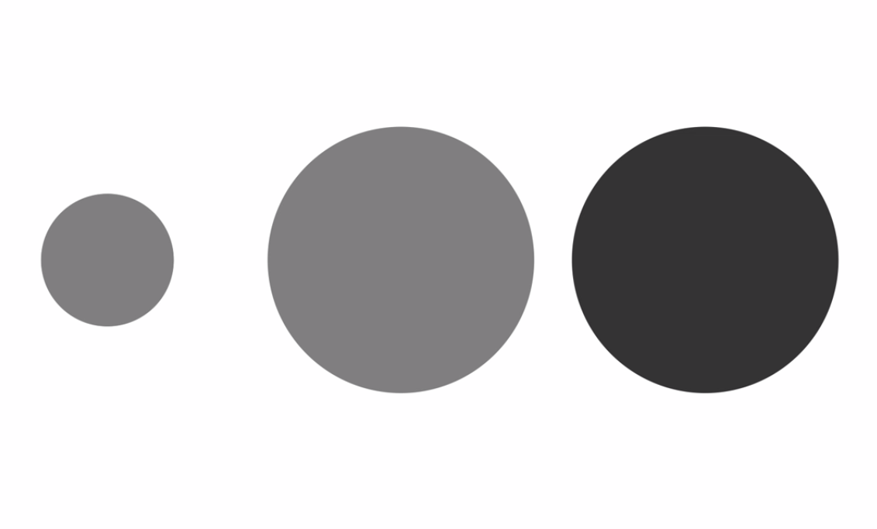
A contrast of size and colour is useful when there is a constant shape.

Slide 35
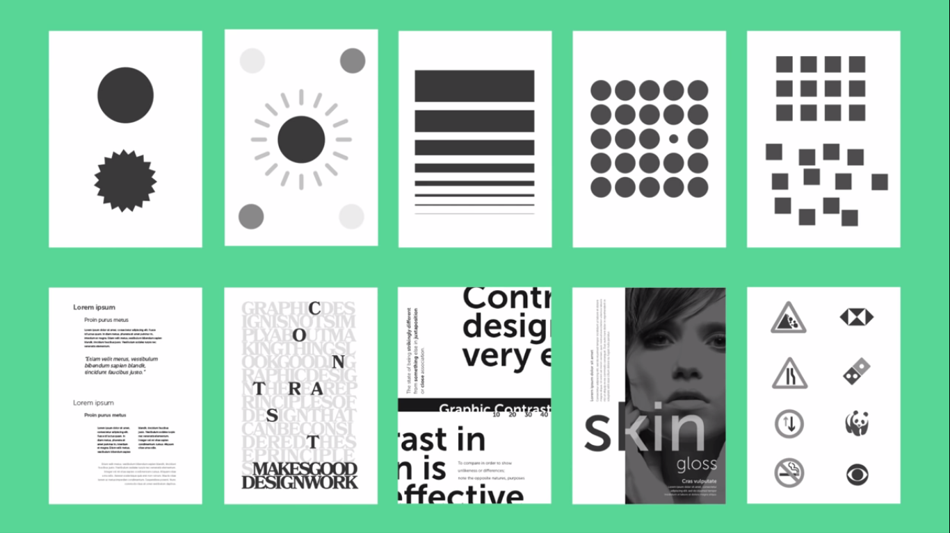
Examples of some well used contrast in design

Slide 36
HIERARCHY
It is typically created by contrast between visual elements in a composition. Naturally visual elements with higher contrast are noticed first.

Slide 37
Establishing clear visual hierarchy is important, because it holds a design together.
Used effectively, hierarchy can make a complex design simple.

Slide 38
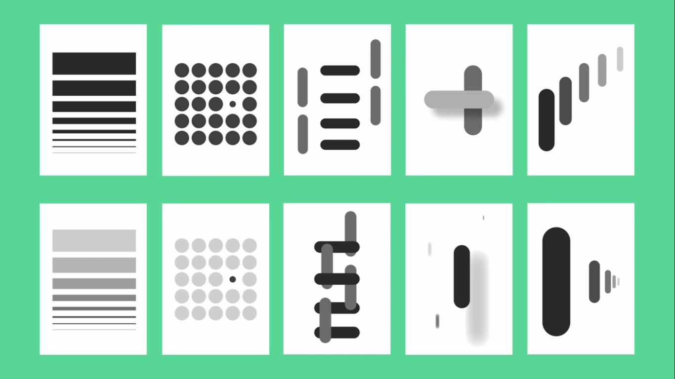

Slide 39
ALIGNMENT
It is the placement of visual components so they line up in a composition

Slide 40
In design, we use alignment to organise elements, group elements, to create balance, to create structure, to create connection between elements and
to create a sharp and clear outcome.

Slide 41

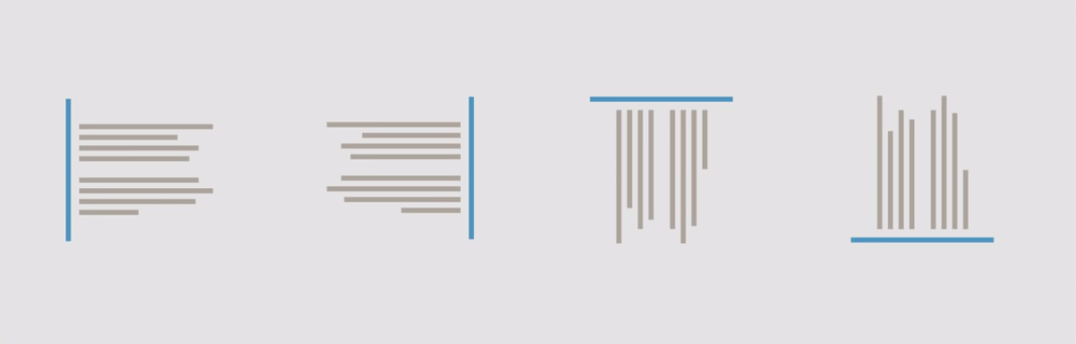
Centre Align
Edge Align

Slide 42
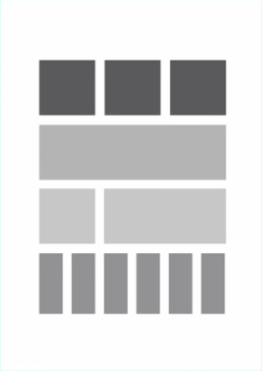


GOOD align
POOR align
MIXED align

Slide 43
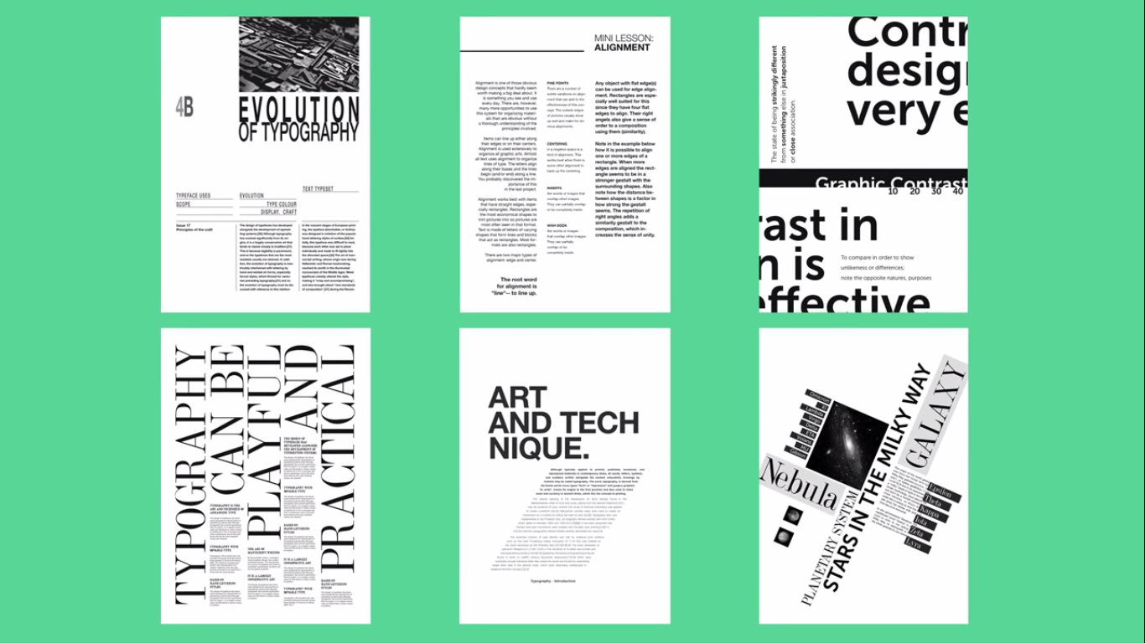

Slide 44
BALANCE
It is the visual weight of elements in a composition.
We use balance to add stability, add structure, create emphasis and to create dynamics

Slide 45
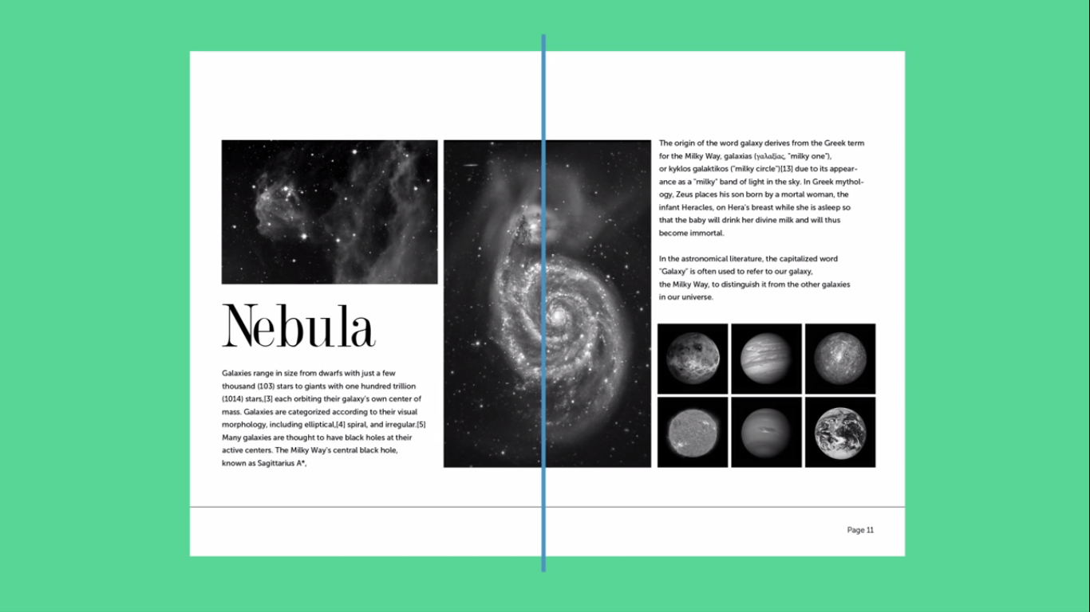
SYMMETRICAL BALANCE

Slide 46
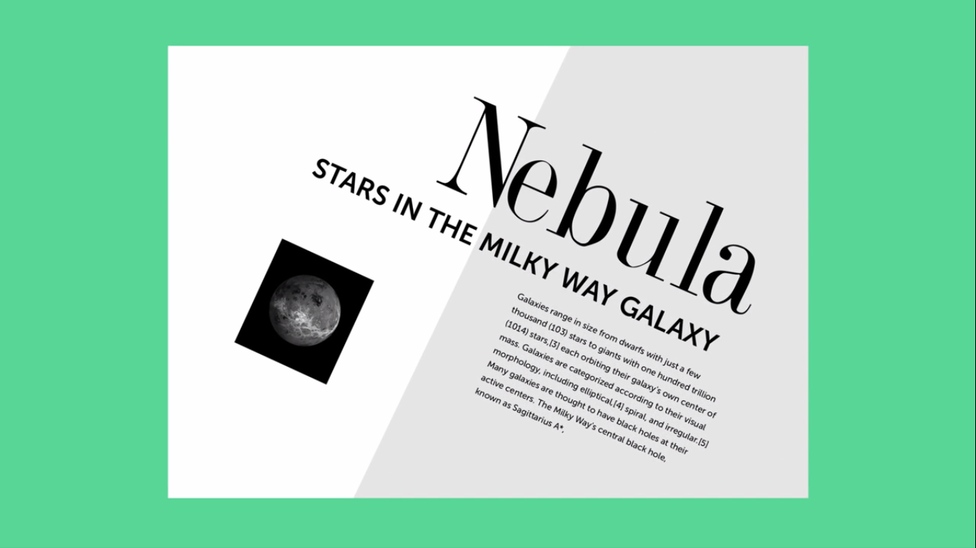
ASYMMETRICAL BALANCE

Slide 47
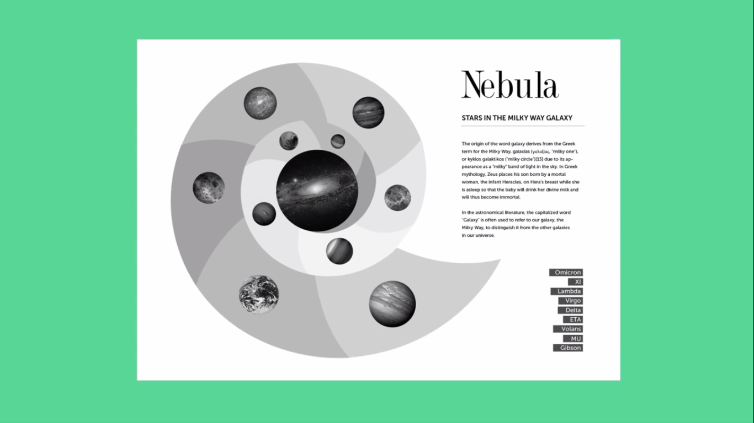
RADIAL BALANCE

Slide 48
PROXIMITY
It is the arrangement of sets of elements in a design to establish relation between certain group of information

Slide 49
It is primarily used to create relationships, relevance, hierarchy, organisation and structure between visual elements of a design.
Rather it is also used to imply the reverse of it too, i.e. to dispel connections.

Slide 50
FOR
EXAMPLE

Slide 51
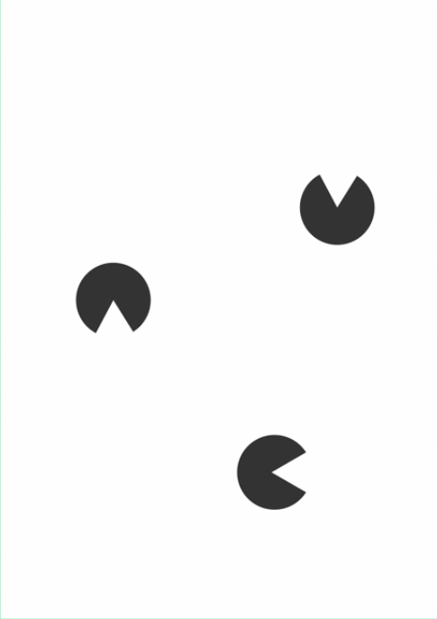

Slide 52
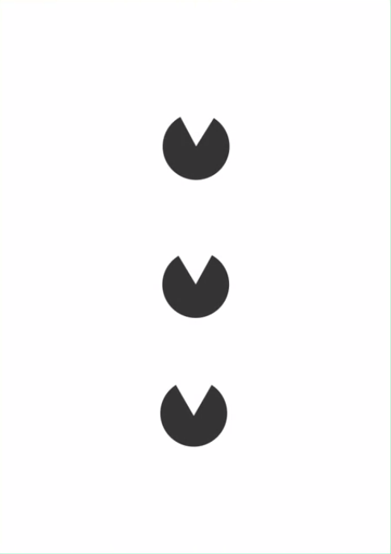

Slide 53


Slide 54
SIMPLICITY
It is the discipline of refining, minimizing or editting back a design

Slide 55
The ultimate goal of any piece of Design is to make an impression, hopefully as lasting impression.
If a design achieves this goal, it will be fulfilling it’s purpose, to communicate and insist upon a particular message.

Slide 56
less
is
more

Slide 57
When you think of some of the most prestigious brands,
it’s common to see:
Simplicity set on a backdrop of complex beauty.

Slide 58
FUNCTION
It is the consideration of the main objective for the product to be developed, and how well the design is explored and executed to meet the demand.

Slide 59
During research, development and design one must always take into account the ‘function’ of the design.

Slide 60
For a beginner,
One may think form is more important than function.
But in reality, simplicity and function should be the first choice.

Slide 61
That’s enough
of
Design Theory
for
today !!!

Slide 62
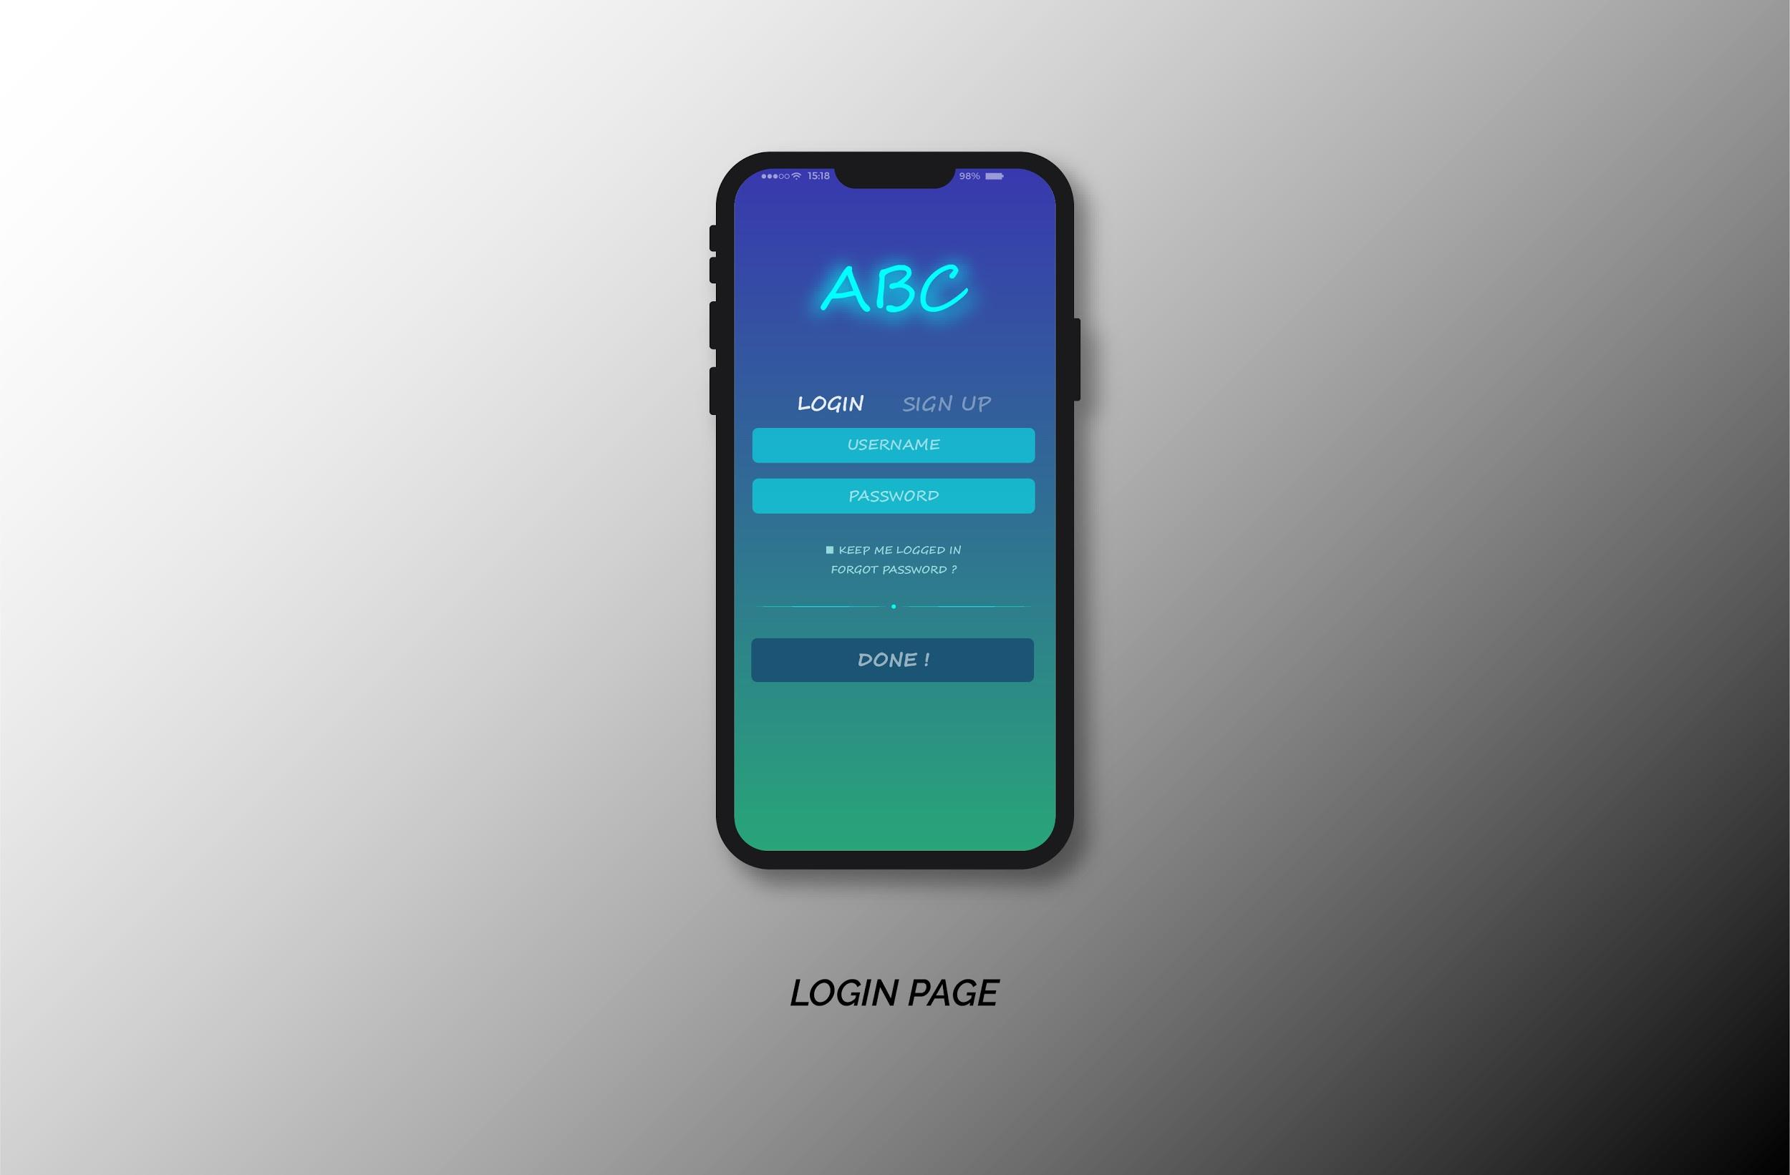

Slide 63
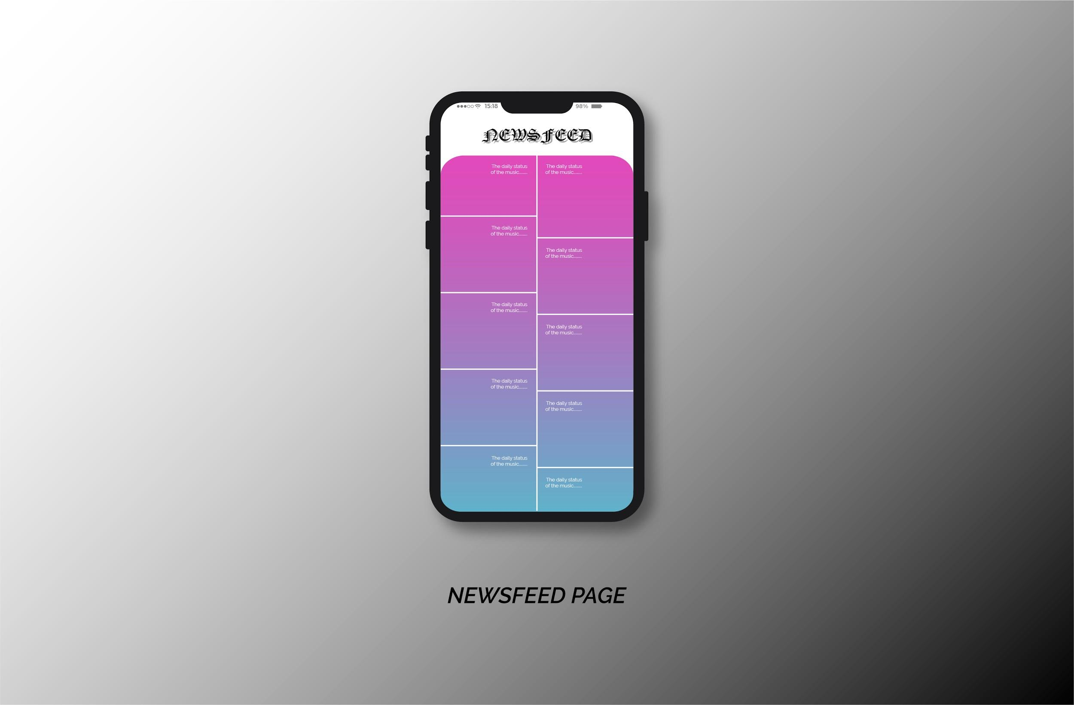

Slide 64


Slide 65
Here is the link to my portfolio,
https://www.behance.net/duttasubhrf1a2

